Slide 1
Employee Data Analysis using Excel
STUDENT NAME:P.KEERTHIGA
REGISTER NO:122202033
DEPARTMENT:B.COM(CORPORATE SECRETARYSHIP)
COLLEGE:ANNA ADARSH COLLEGE FOR WOMEN

Slide 2
PROJECT TITLE
Employee Performance Analysis using Excel

Slide 3


AGENDA
Problem Statement
Project Overview
End Users
Our Solution and Proposition
Dataset Description
Modelling Approach
Results and Discussion
Conclusion
3/21/2024 Annual Review

Slide 4

PROBLEM STATEMENT 1.Informed Decision-Making 2. Identifying Trends and Patterns 3. Improving Recruitment and Retention 4. Optimizing Workforce Planning 5. Enhancing Employee Development 6. Boosting Employee Engagement 7. Benchmarking and Competitive Analysis 8. Compliance and Risk Management

Slide 5

PROJECT OVERVIEW OBJECTIVE: Objective:The primary objective of this project is to systematically analyse employee performance across the organization identify key factors affecting performance, and develop strategies to improve overall productivity, engagement, and job satisfaction. Employee performance analysis is crucial for several reasons: 1.Improving Productivity 2. Enhancing Job Satisfaction 3. Aligning Goals and Expectations 4. Identifying Training Needs 5. Boosting Engagement 6. Reducing Turnover 7. Supporting Decision-Making 8. Enhancing Team Dynamics 9.Benchmarking and Goal Setting 10. Ensuring Fairness and Equity
.

Slide 6

WHO ARE THE END USERS? Employee performance analysis is valuable tool for various stakeholders within an organization. Here are some of the key end users:Human resource department Managers and team leaders Executives and senior management. ➤ Employees Training and development teams Data analysts

Slide 7

OUR SOLUTION AND ITS VALUE PROPOSITION SOLUTION FOR EMPLOYEE PERFORMANCE ANALYSISVALUE PROPOSITION➤ Data collection and integrationEnhanced productivity ➤ Performance metricsEmployee engagement and retention ➤ Advanced analytics.Data-driven decisions ➤ Personalised insightsImproved organizational performance ➤ Continuous feedback and ImprovementScalability and flexibility OUR SOLUTION AND ITS VALUE PROPOSITION SOLUTION FOR EMPLOYEE PERFORMANCE ANALYSISVALUE PROPOSITION ➤ Data collection and integrationEnhanced productivity ➤ Performance metricsEmployee engagement and retention ➤ Advanced analytics.Data-driven decisions ➤ Personalised insightsImproved organizational performance ➤ Continuous feedback and ImprovementScalability and flexibility

Slide 8
Dataset Description When creating a dataset for employee performance analysis, it is crucial to include a variety of data points to ensure a comprehensive understanding of performance factors. Here’s a detailed description of a typical employee performance dataset: 1. Employee Information 2. Performance Metrics 3. Behavioral and Soft Skills 4. Attendance and Punctuality 5. Training and Development 6. Feedback and Reviews 7. Compensation and Rewards 8. Employee Engagement 9. Exit Information
Notes:
When creating a dataset for employee performance analysis, it is crucial to include a variety of data points to ensure a comprehensive understanding of performance factors. Here’s a detailed description of a typical employee performance dataset:

Slide 9

THE "WOW" IN OUR SOLUTION Formula used for finding the performance level of employees =IFS(28>=5,"VERY HIGH", ZB>=4, "HIGH".28>=3,"MED".TRUE,"LOW")
3/21/2024 Annual Review
9

Slide 10
MODELING:
Collection and Preparation WorkflowData
Download the Dataset:
Download the dataset from the eciunet dashboard.
Open the Dataset:
Open the dataset in Excel.
Data Cleaning:
Filter Data:
Use the filter option in Excel to separate out blank entries or irrelevant data.
10
Notes:
Fff

Slide 11
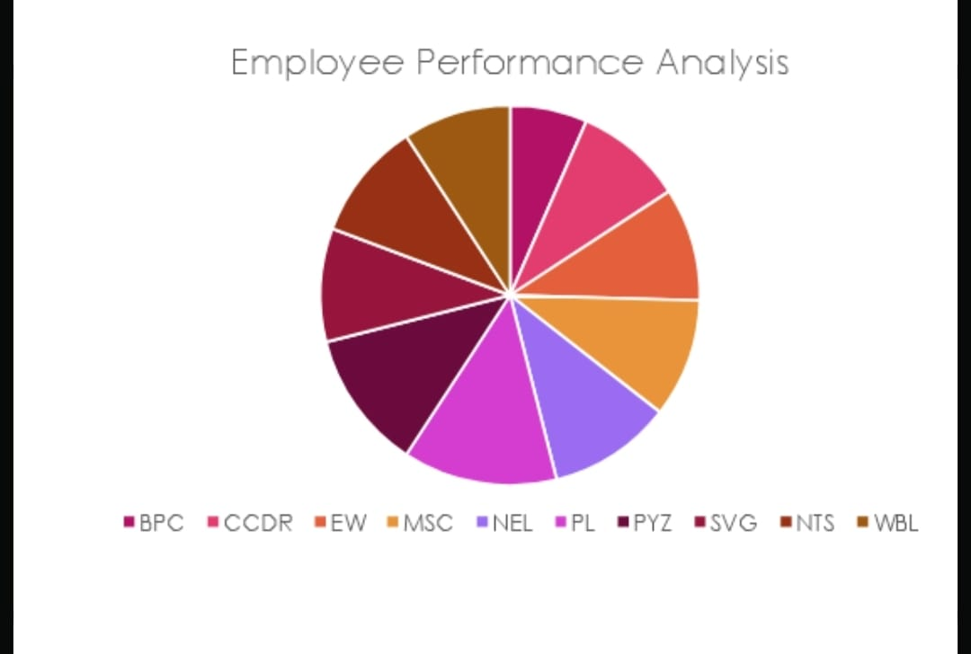
RESULTS
11

Slide 12
Conclusion In any organization, the main task is people handling because the main task is to manage people who are the main assets of the organization as they are the person to fulfil the ultimate goal of the company. There is a saying that "when you are an employee, success definition for you to grow yourself but at the time when you become a leader the definition of success is to grow others. And that is where employee performance analysis plays a huge role".

